Slide 1
EmpowHer
EmpowHER: Empowering Girls for Corporate Excellence Technical Curriculum <Tech>

Slide 2
Agenda Week 1
Tip: Use infographics,
Smart Art,
Images/Screens,
Embed relevant learning videos/case study

Slide 3
Topic Week 1

Slide 4
Agenda Week 2
Tip: Use infographics,
Smart Art,
Images/Screens,
Embed relevant learning videos/case study

Slide 5
Topic Week 2

Slide 6
Agenda Week 3
Tip: Use infographics,
Smart Art,
Images/Screens,
Embed relevant learning videos/case study

Slide 7
Topic Week 3

Slide 8
Agenda Week 4
Tip: Use infographics,
Smart Art,
Images/Screens,
Embed relevant learning videos/case study

Slide 9
Topic Week 4

Slide 10
Agenda Week 5
Tip: Use infographics,
Smart Art,
Images/Screens,
Embed relevant learning videos/case study

Slide 11
Topic Week 5

Slide 12
Agenda Week 6
Tip: Use infographics,
Smart Art,
Images/Screens,
Embed relevant learning videos/case study

Slide 13
Topic Week 6

Slide 14
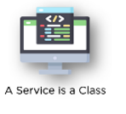
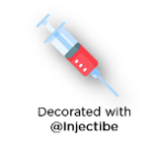
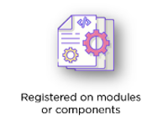

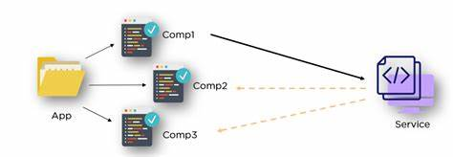
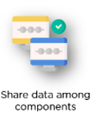

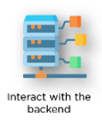
Agenda Week 7 - Angular Services
A service is typically a class with a narrow, well-defined purpose. A service can be any value, function, or feature that an application needs. It should do something specific and do it well.
Why We should use Service ?

Slide 15
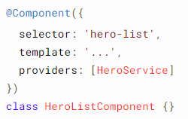
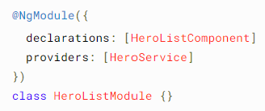
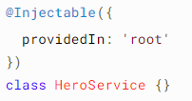

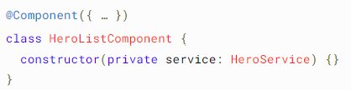
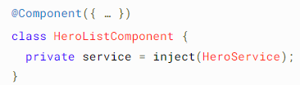
Agenda Week 7 - Angular DI
Dependency injection (DI) provides components a way to access services and other resources.
Providing dependency
OR OR
Injecting a dependency
OR

Slide 16
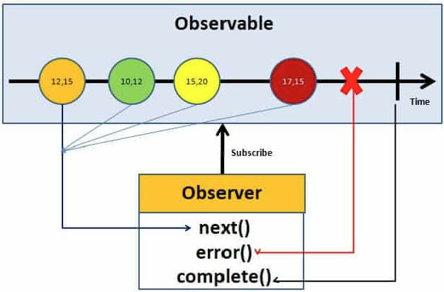
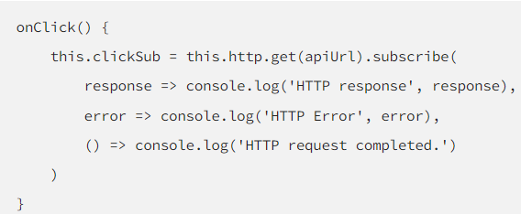

Agenda Week 7 - Angular Observable and Http
Observable is like a data source. It is from Rxjs.
Implemented by following an observable pattern. where we have an observable and an observer and in between, we have a timeline where we can have multiple events, or data packages, emitted by the observable.
HttpClient service is available as an injectable class, with methods to perform HTTP requests. Each request method has multiple signatures, and the return type varies based on the signature that is called
Subscribing to an Observable Un-Subscribing to an Observable

Slide 17
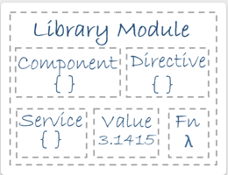

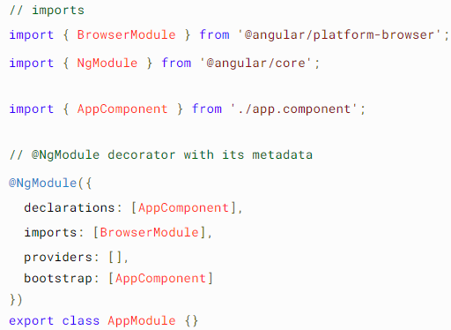
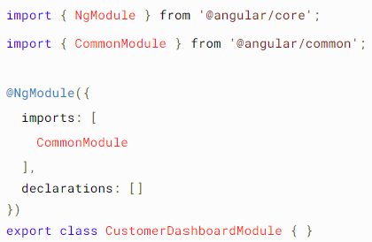
Agenda Week 8 – Angular Modules
Angular has its own modularity system called NgModules. NgModules are containers for components, service providers, and other code files whose scope is defined.
Every Angular application has at least one Generate Module Using Angular CLI NgModule class, app.module.ts

Slide 18

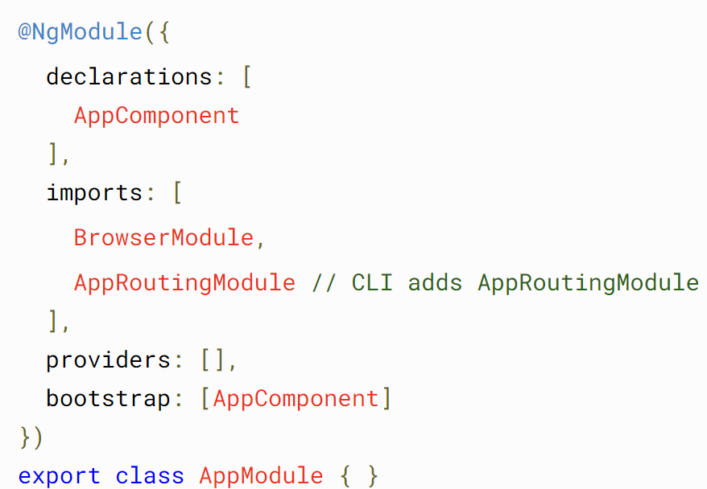
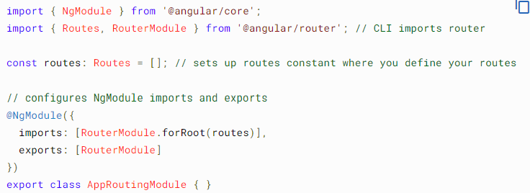
Agenda Week 8 – Angular Routing
To handle the navigation from one view to the next, you use the Angular Router. The Router enables navigation by interpreting a browser URL as an instruction to change the view.
Generate Routings with Angular CLI
Changes to the App Module CLI Generated Routing module

Slide 19
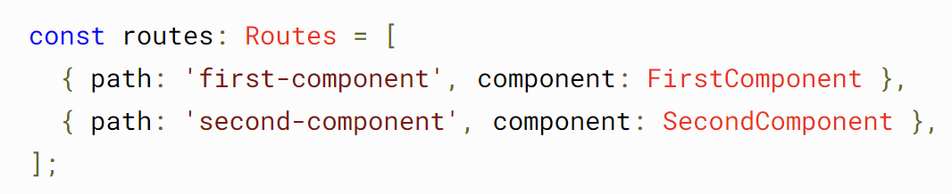


Agenda Week 8 – Angular Routing
Configuring the Routes
Setting up redirections
Configuring the Wild Cards or Display 404 page.
Lazy Loading

Slide 20

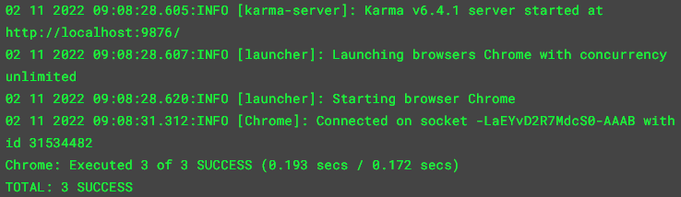
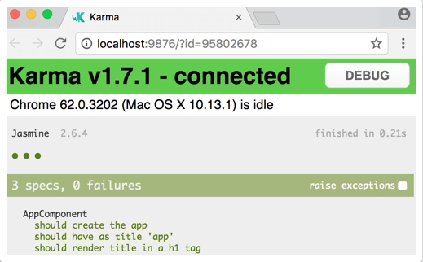

Agenda Week 9 – Angular Unit Testing.
Testing your Angular application helps you check that your application is working as you expect.
You can Test Components, Services, Directives, Pipes, Routes, etc.
Setting Up Tests Project you create with the CLI is immediately ready to test. Just run the CLI command
Console output looks the below Browser output looks the below
Find the Code Coverage with CLI Command

Slide 21
Topic Week 9

Slide 22
Agenda Week 10
Tip: Use infographics,
Smart Art,
Images/Screens,
Embed relevant learning videos/case study

Slide 23
Topic Week 10

Slide 24
Appendix
Add Links or permissible Images as needed

